Slide 1
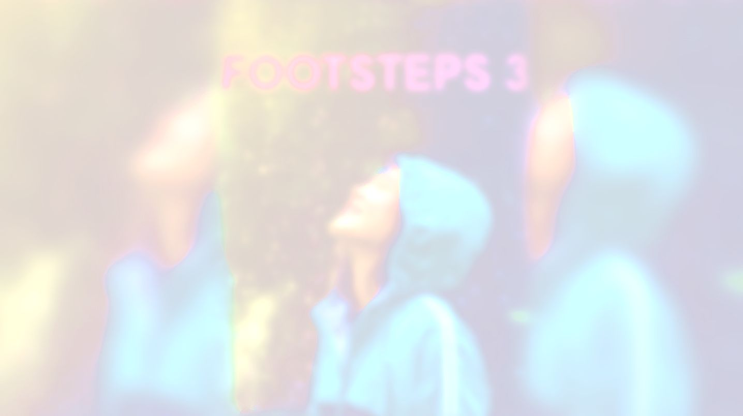


UNIT 2; Time to enjoy
Time savers

Slide 2
Translate:
household appliances
vacuum cleaners
a prototype
an oven
a refrigerator
to take something for granted
to heat
to sweep
a broom
straw
kućanski aparati
usisavači
prototip, probni model
pećnica
hladnjak
uzeti nešto zdravo za gotovo, podcijeniti
zagrijati
pomesti
metla
slama
to replace
to suck in
to insert
a tube
a flaw
a grocery list
a fireplace
bricks
convenient
a chimney
a downside
zamijeniti
usisati
ubaciti
cijev
mana, nedostatak
popis namirnica za kupovinu
kamin
cigle
pogodno
dimnjak
nedostatak

Slide 3
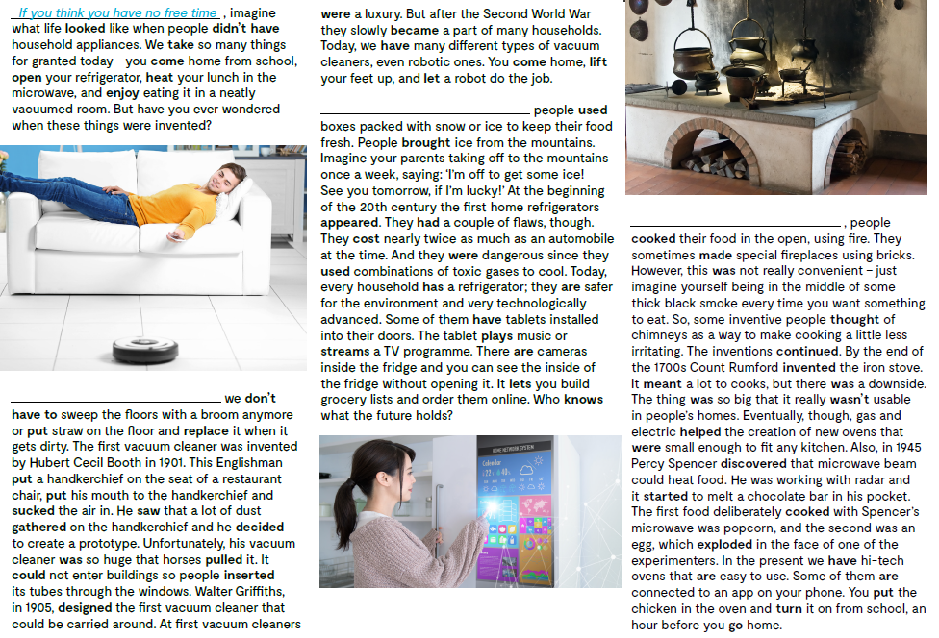
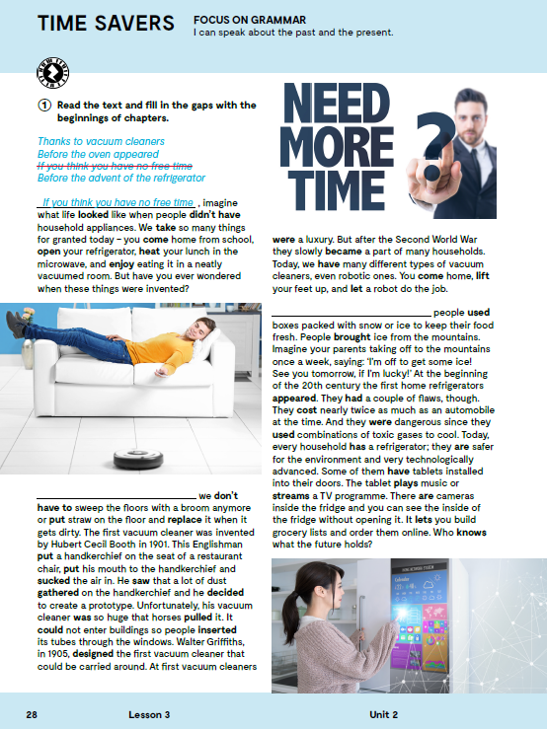

Read the text and fill in the gaps with the beginnings of chapters.
Before the advent of the refrigerator
Before the oven appeared
Check!
Thanks to vacuum cleaners

Slide 4
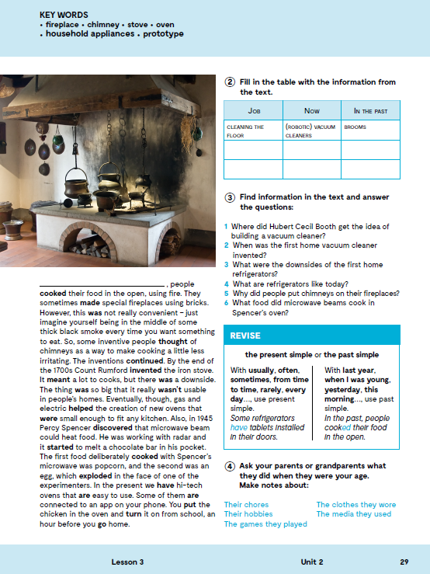
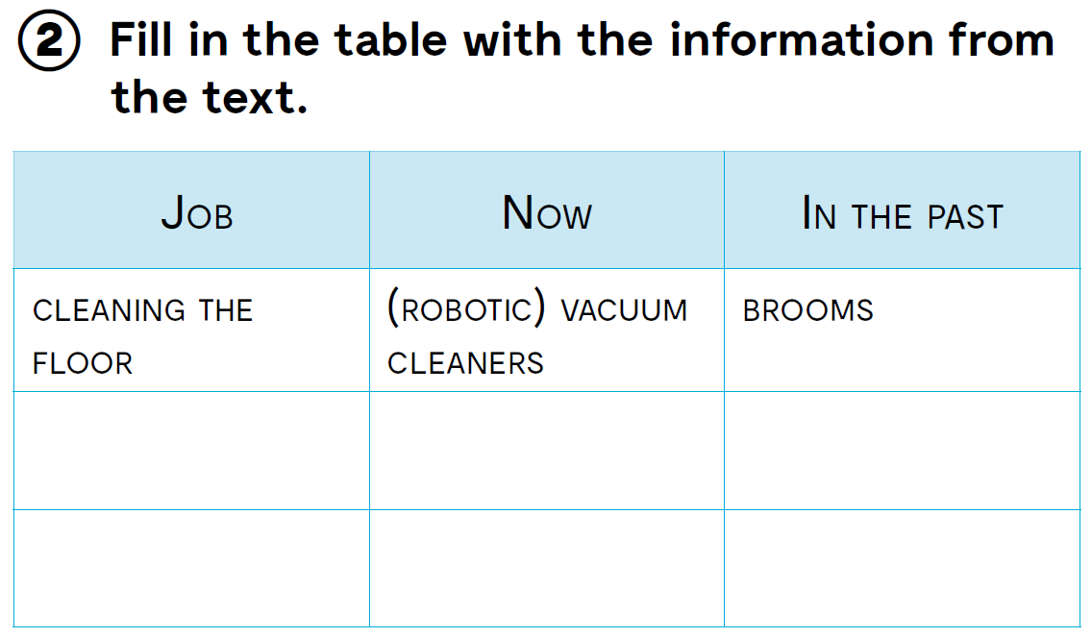
boxes packed with snow and ice
keeping food fresh
refrigerator
cooking food
ovens
fireplaces

Slide 5

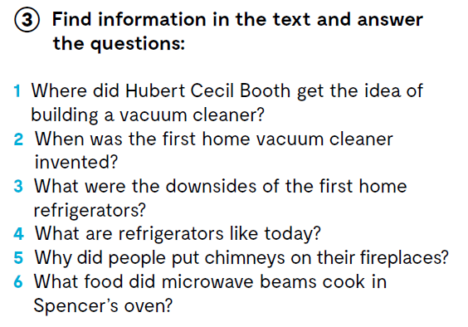
1 He got the idea of building a vacuum cleaner at a restaurant.
2 The first home vacuum cleaner was invented in 1905.
3 The first home refrigerators were very expensive and dangerous because of toxic gases.
4 Today, refrigerators are safer for the environment and very technologically advanced.
5 People put chimneys on their fireplaces because there was too much black smoke every time they cooked.
6 Popcorn and egg were cooked in Spencer's oven.

Slide 6

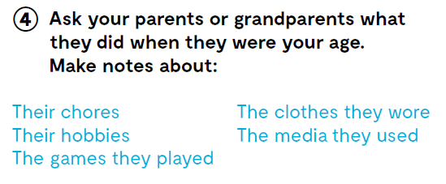

Slide 7
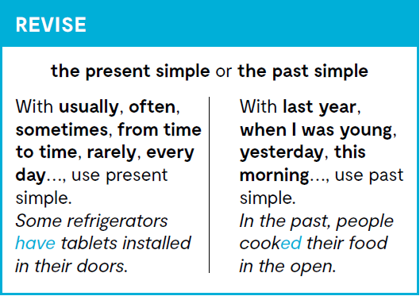
Kada govorimo o radnji u prošlosti koristimo PAST SIMPLE, a kada govorimo o radnji koja se događa u sadašnjosti koristimo PRESENT SIMPLE.

Slide 8
PRESENT SIMPLE VS PAST SIMPE
Present Simple tense dobivaš dodavanjem nastavka -s ili -es glagolu u 3. osobi jednine (HE/SHE/IT), dok u svim ostalim osobama koristiš infinitiv glagola. We take so many things for granted. The tablet plays musicor streams a TV programme.
Past Simple tense pravilnih glagola dobivaš dodavanjem nastavka -d ili -ed glagolu, dok nepravilne glagole učimo napamet iz tablice nepravilnih glagola. Imagine what life looked like… He saw that a lot of dust gathered on the handkerchief…
U niječnom obliku ispred glagola u infinitivu stavljamo doesn’t u 3. osobi jednine, dok u svim ostalim osobama ispred infinitiva glagola stoji don’t. We don’t have to sweep the floors… He doesn’t know what the future holds!
U niječnom obliku ispred glagola u infinitivu stavljamo didn’t. Imagine what life looked like when people didn’t have household appliances.
U upitnom obliku ispred subjekta stavljamo Does, dok u svim ostalim osobama ispred subjekta stoji Do. Glagol u rečenici ostaje u infinitivu! Do you cook? Does he eat lasagna?
U upitnom obliku ispred subjekta stavljamo Did, dok glagol u rečenici ostaje u infinitivu. Did you use the microwave?

Slide 9
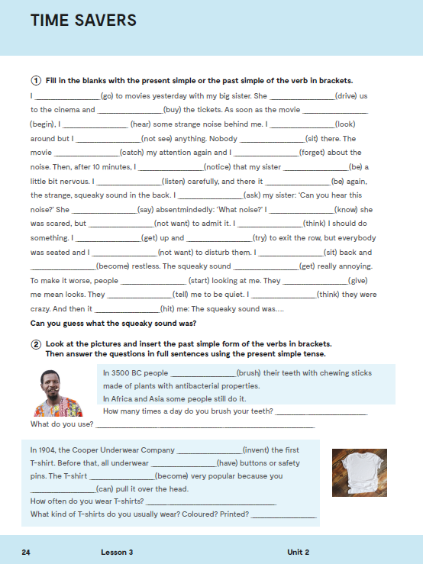
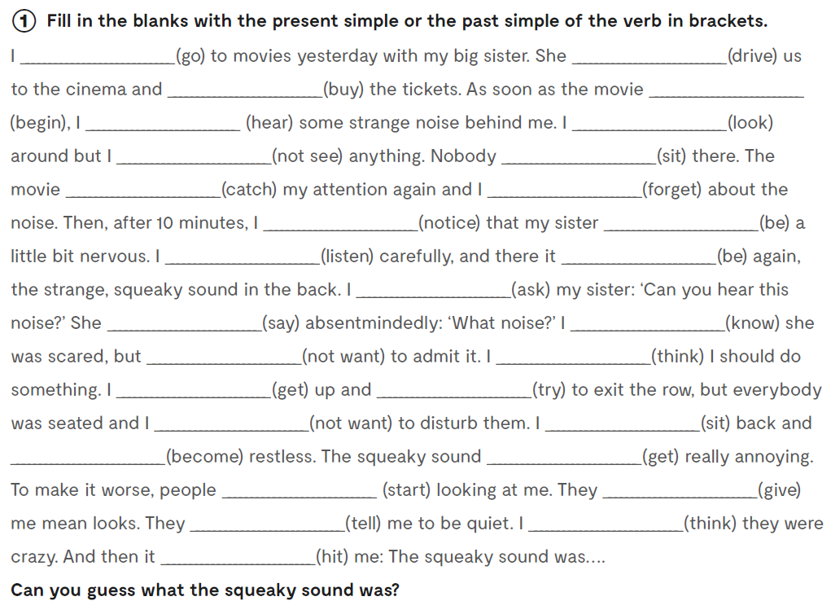

Workbook, p. 24
Practise: https://learningapps.org/watch?v=p7woas6wc20
went
drove
bought
began
heard
looked
didn’t see
sat
caught
forgot
noticed
was
listened
was
asked
said
knew
didn’t want
thought
got
tried
didn’t want
sat
became
got
started
gave
told
thought
hit

Slide 10
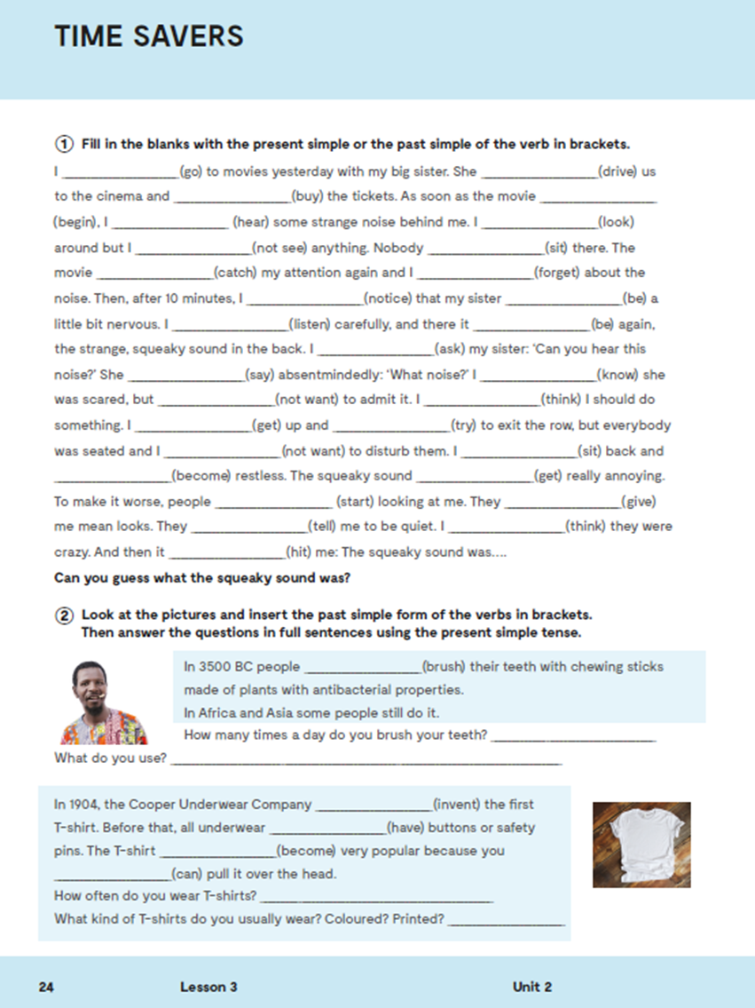
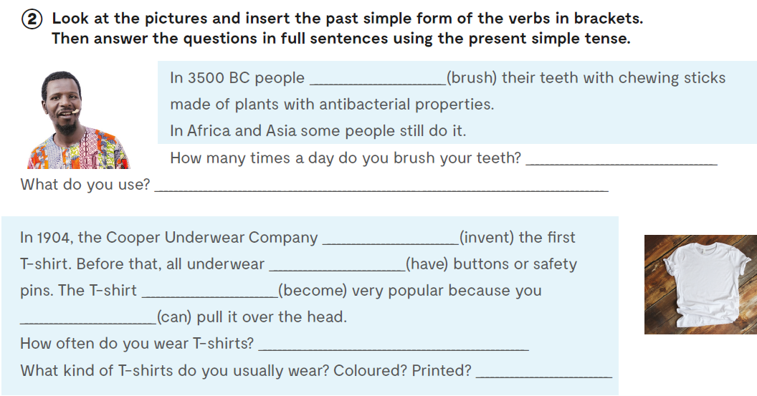
brushed
invented
had
became
could

Slide 11
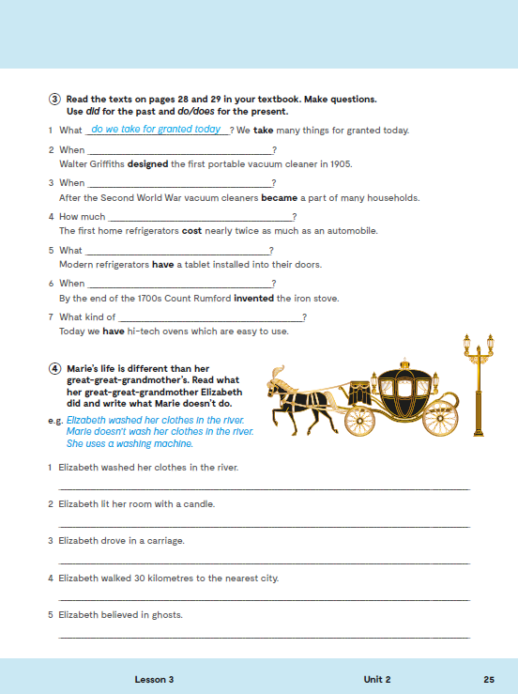
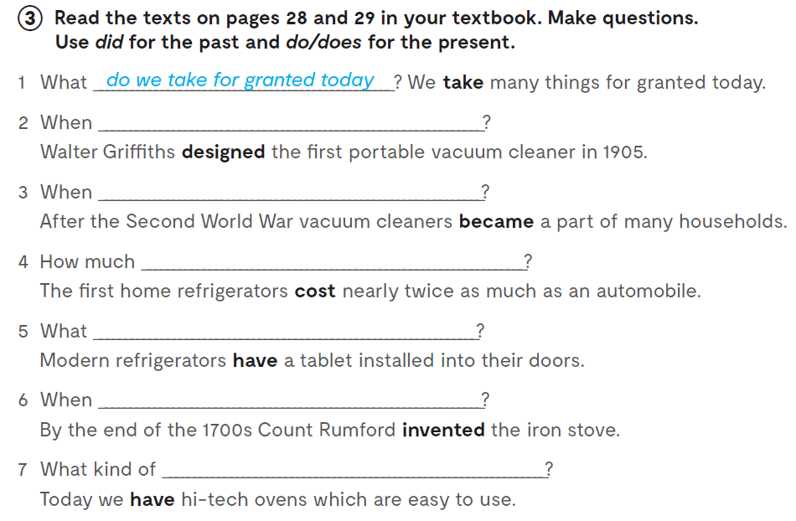
did Walter Griffiths design the first portable vacuum cleaner?
did vacuum cleaners become a part of many households?
did the first home refrigerator cost
do modern refrigerators have installed into their doors?
did Count Rumford invent the iron stove?
ovens do we have today

Slide 12
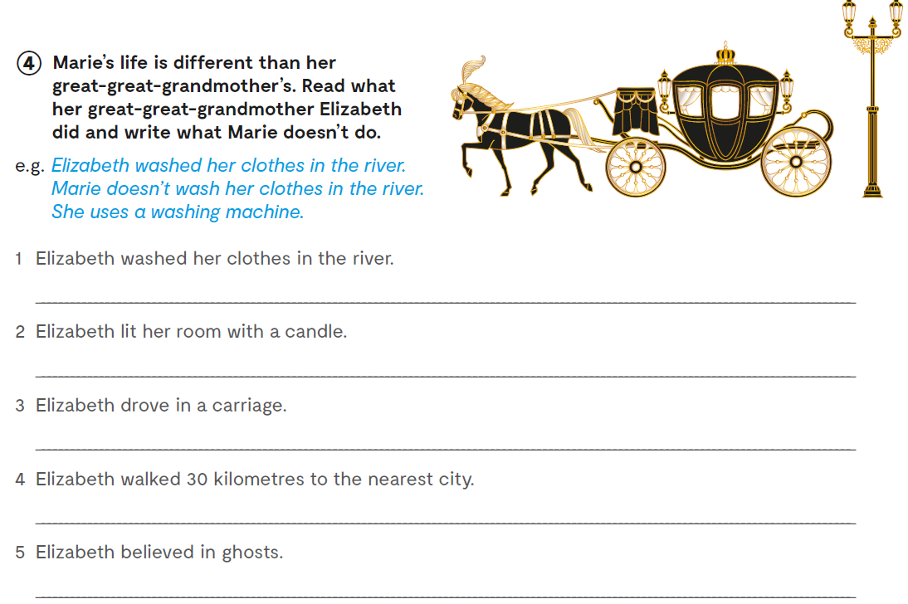

Slide 13

LEARN MORE!
https://www.e-sfera.hr/dodatni-digitalni-sadrzaji/224c7045-8ab3-4ac3-910d-83ea5bf39365/
Appliances of the past: What were they used for?

